Slide 1
Cloud : deploy and visualise

Slide 2



amazon RDS
scenario
on premise server

Slide 3
data visualisation

Slide 4
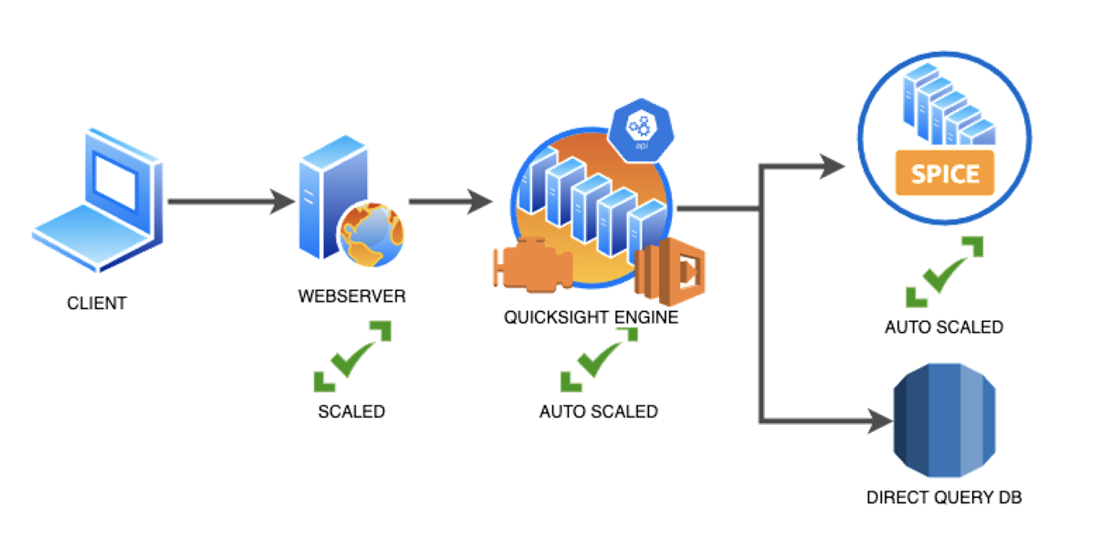
quicksight
cloud data analysis

Slide 5

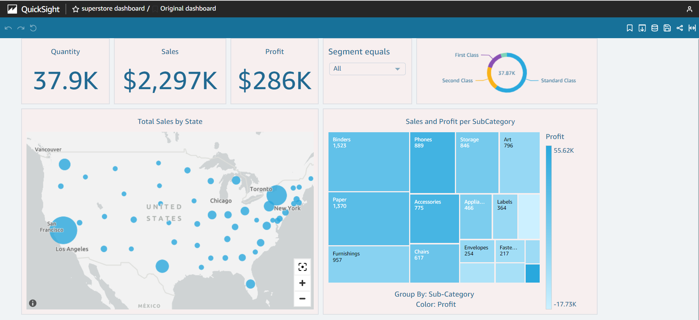


data
analysis
dashboard
share
Notes:
walk through basics of quicksight from a csv
create analysis eg bar chart for customers and deploy as dashboard before sharing as link
https://eu-central-1.quicksight.aws.amazon.com/sn/dashboards/089f938e-6eb7-4c3b-80f1-0ea5b8825e74/views/aeb33053-2e12-496b-a448-fe84df13b547
or create users and groups/ invite
all steps are in the instructors notes

Slide 6
target dashboard
Notes:
demonstrate dashboard filtering functionality

Slide 7
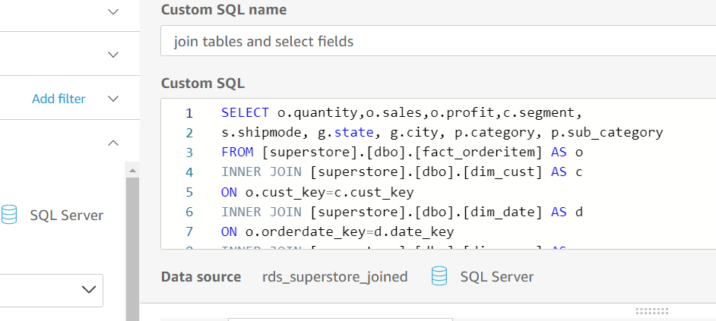
create custom sql data source
Notes:
rather than connecting to 5 data sources and joining them in quicksight, which creates redundancy, the idea is to create a query which captures all the fields we need for our dashboard
ideally refer back to the dashboard to collect on the whiteboard which fields we need and create the query together
all steps are in the instructors notes and sample query (non aggregated) is provided

Slide 8
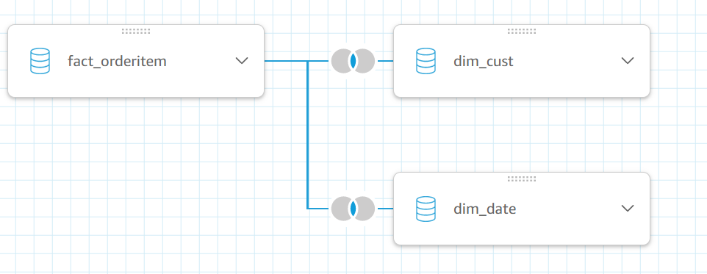
join tables together in data source
Notes:
rather than connecting to 5 data sources and joining them in quicksight, which creates redundancy, the idea is to create a query which captures all the fields we need for our dashboard
ideally refer back to the dashboard to collect on the whiteboard which fields we need and create the query together
all steps are in the instructors notes and sample query (non aggregated) is provided

Slide 9
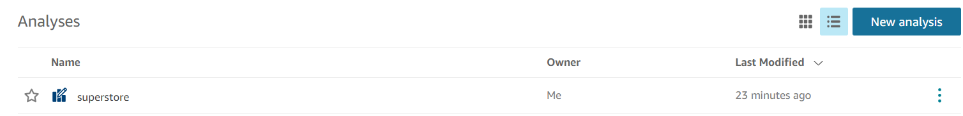
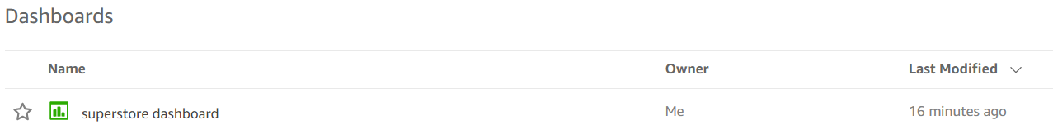
upstream components
Notes:
high level tour of the interface for quicksight

Slide 10
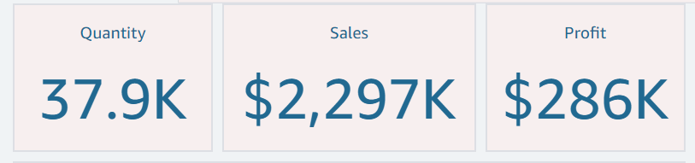
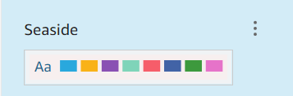
downstream components
kpis
theme
Notes:
walk through components
all steps are in the instructors notes

Slide 11
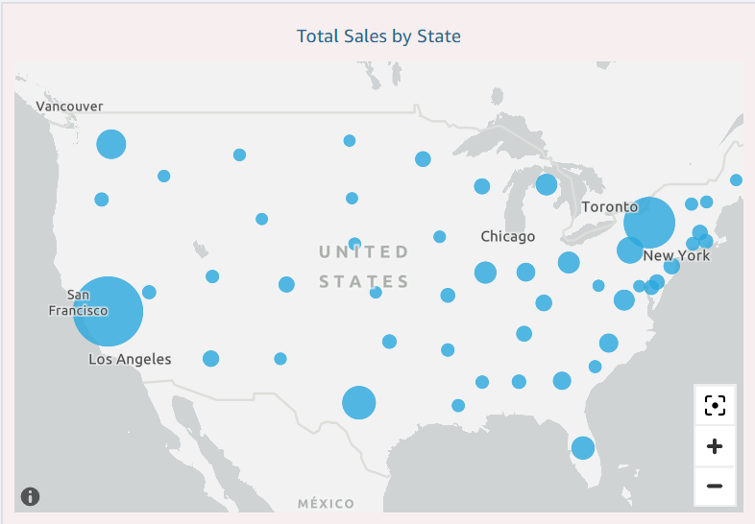
downstream components
map
Notes:
walk through components
all steps are in the instructors notes

Slide 12
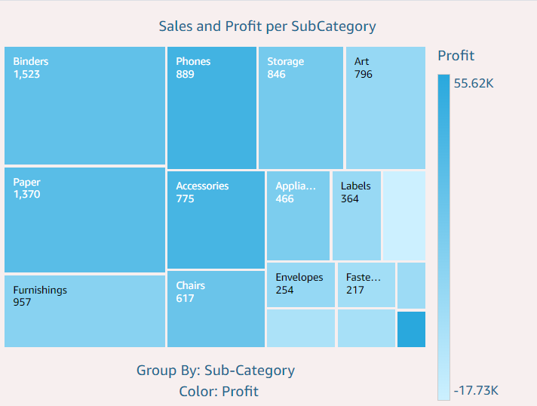
downstream components
tree
map
note the definition can be edited
Notes:
walk through components
all steps are in the instructors notes

Slide 13
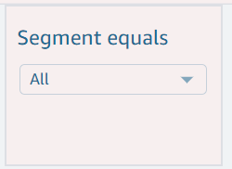
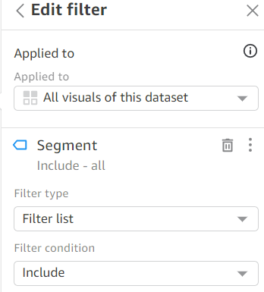
downstream components
filter
Notes:
walk through components
all steps are in the instructors notes

Slide 14
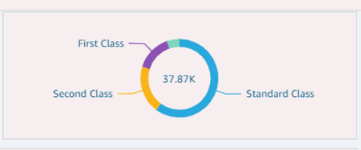
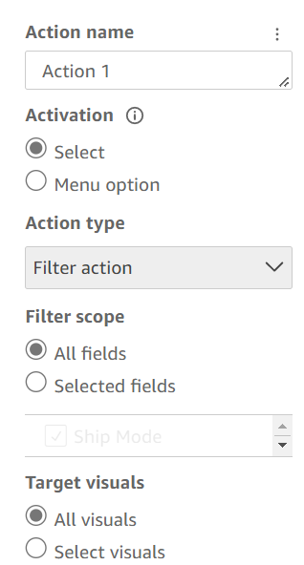
downstream components
donut
action
Notes:
walk through components
all steps are in the instructors notes

Slide 15
Review and monitor

Slide 16
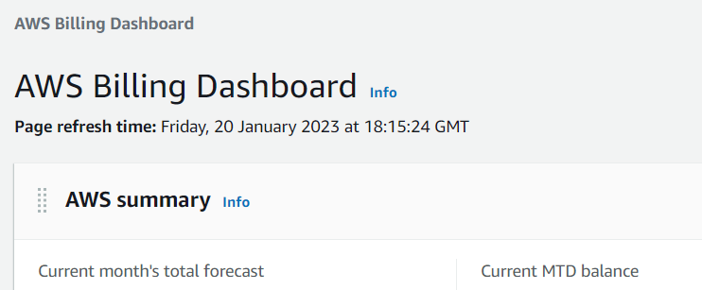

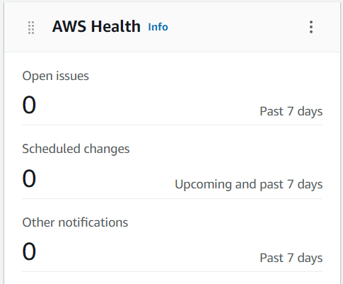

monitor your vpc
Notes:
return to aws console home and explore billing dashboard, health
all steps are in the instructors notes

Slide 17
complete the cloud migration of superstore database
or
upload superstore csv- file
design superstore dashboard
create analysis
publish and share dashboard
manage / monitor your VPC
your next steps

